Slide 1
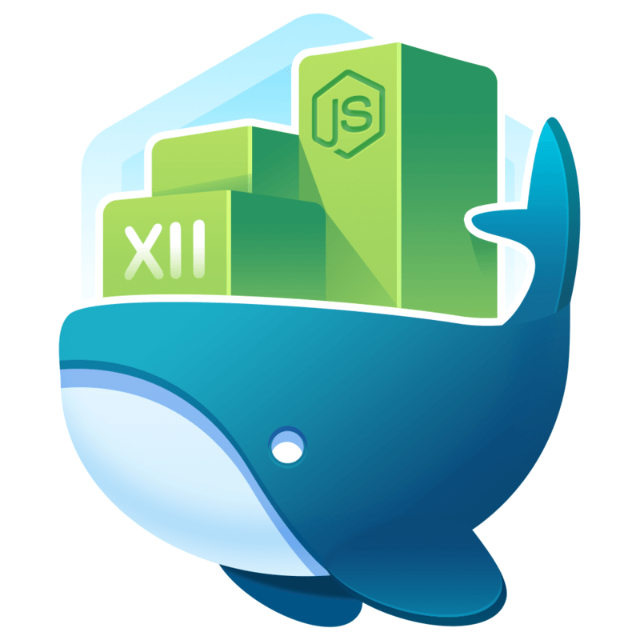
Whale watching
Another Docker talk
Chris Wharton, Daniele Iasella

Slide 2
Agenda
VM vs Container?
Docker introduction
Demo

Slide 3
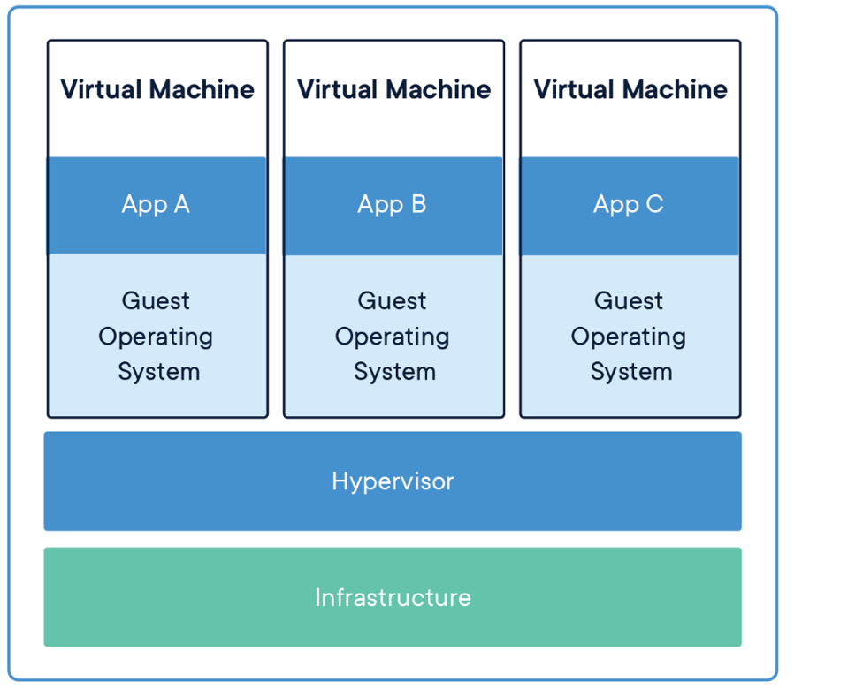
Virtual Machine
Abstraction of physical hardware
Includes a full copy of an operating system, the application, necessary binaries and libraries.

Slide 4
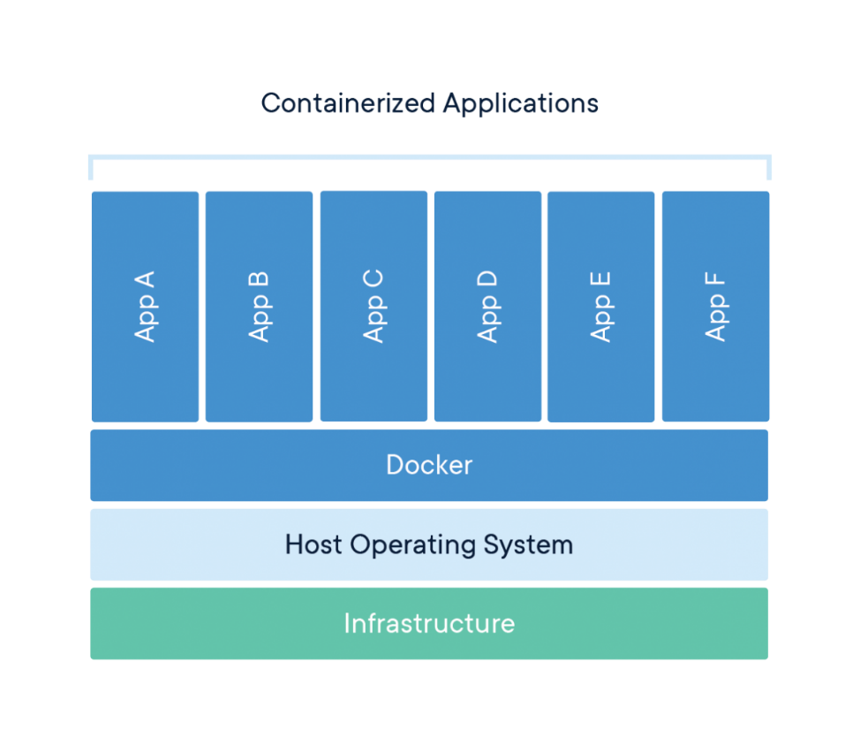
What is a container?
It is a standard unit of software that packages up code and all its dependencies.
It can share the OS kernel with other containers

Slide 5
What is Docker?
An open platform for developing, shipping and running applications.
Components:
Docker daemon – docker engine API
Docker objects – containers, images, services
Registries – Docker Hub
Tools:
Docker compose – define and run multicontainer applications.
Docker swarm – clustering functionality to docker containers

Slide 6
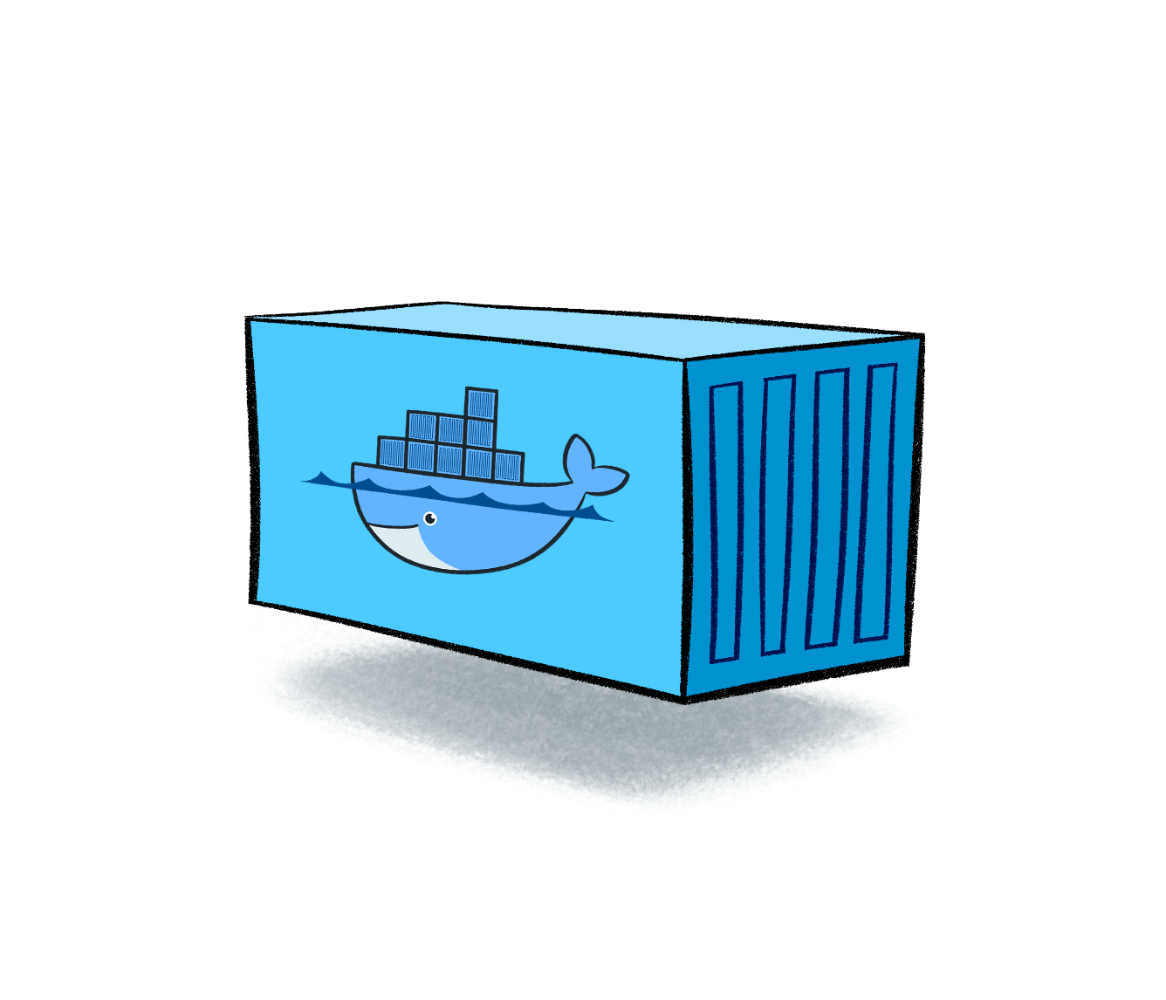
Images and containers
An image is essentially a template.
Created with the docker build command.
Can be built from other images in layers.
A container is a running instance of an image.
Started with the docker run command.

Slide 7
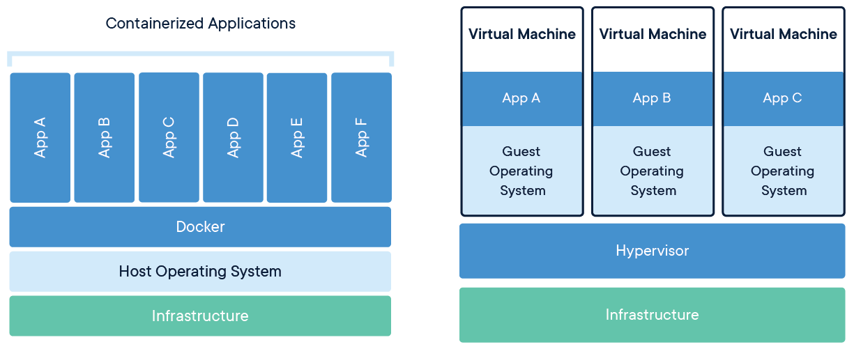
Containers vs Virtual Machines

Slide 8
Why Docker is so cool? Why is it good for Abcam?
Fast and less overhead (compare to VMs)
Image versioning
Portable (with some caveat)

Slide 9
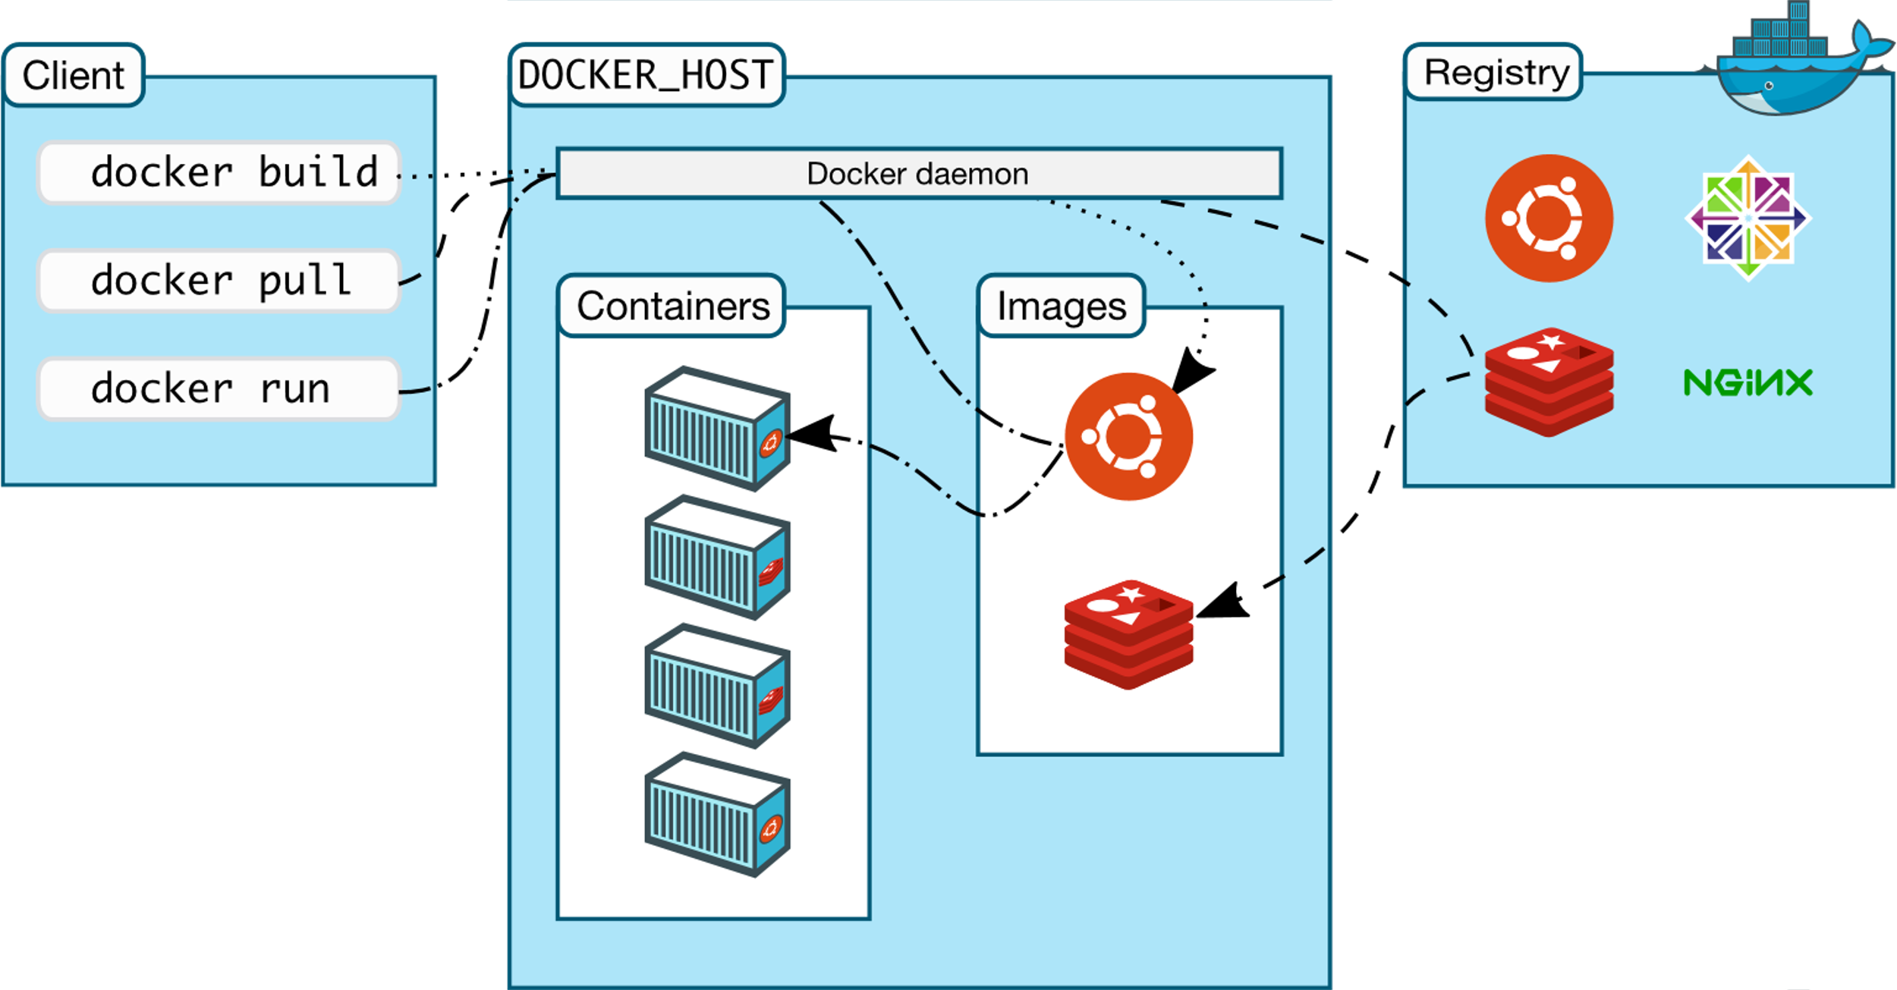
Docker architecture

Slide 10
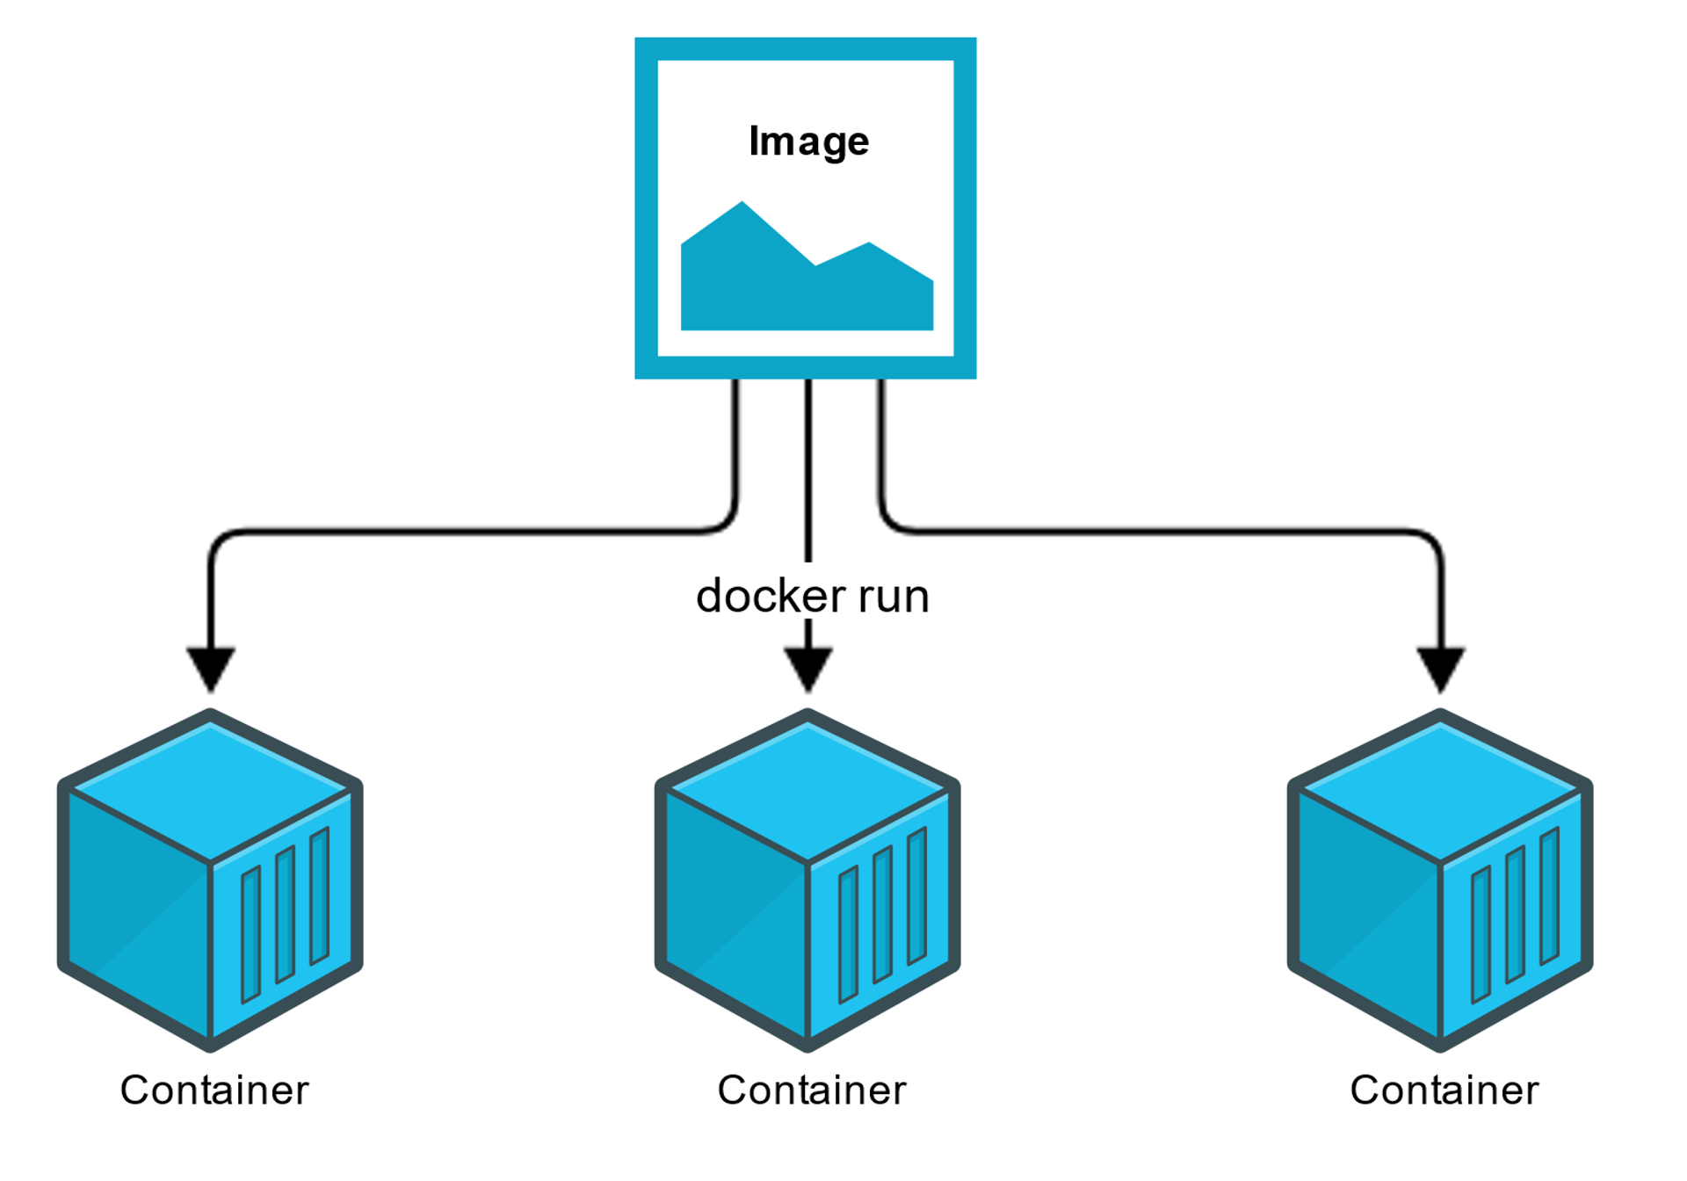
Docker demo – docker run

Slide 11
Docker demo – run a container
docker run [OPTIONS] IMAGE [COMMAND] [ARG...]
docker run alpine echo “I’m running within the container"
docker run -i -t alpine ash
-i interactive mode
-t pseudo-tty
ash is Alpine’s default shell (instead of bash)
Notes:
docker run alpine echo "Hi abcammers"
Process Status
docker ps
docker ps -a
watch 5 "docker container ls"
docker run -it alpine ash
docker ps

Slide 12
Docker demo - networking in Docker Desktop
Connect from container to host machine
DNS name host.docker.internal resolves to the internal IP address used by the host.
The gateway is also reachable as gateway.docker.internal.
Connect from host to container
Using port forwarding, ports exposed in linux will be forwarded to the host. docker run –p 80:8080 mywebapp
Notes:
Speak about docker hub again
https://hub.docker.com/r/pulsesecure/vtm/
docker run --name=vanilla-vtm -e ZEUS_EULA=accept -e ZEUS_PASS=admin -t -d pulsesecure/vtm:20.1
docker exec -i -t <container ID> /bin/bash
docker run --name=vanilla-vtm -e ZEUS_EULA=accept -e ZEUS_PASS=admin -t -d -p 9090:9090 pulsesecure/vtm:20.1
http://localhost:9090/

Slide 13
Docker demo – Extend ZXTM
Notes:
Dockerfile
Each command will produce a layer
Speak about difference between RUN (build time) and CMD (container time)
docker build -t abcam-zxtm:1.0 .
docker run --name=abcam-vtm -t -d -p 9090:9090 abcam-zxtm:latest
docker images
(docker image ls)
Modify dockerfile
docker build -t abcam-zxtm:2.0 .
docker images
docker tag abcam-zxtm:1.0 abcam-zxtm:latest
→ Show layers
docker history abcam-zxtm:2.0

Slide 14
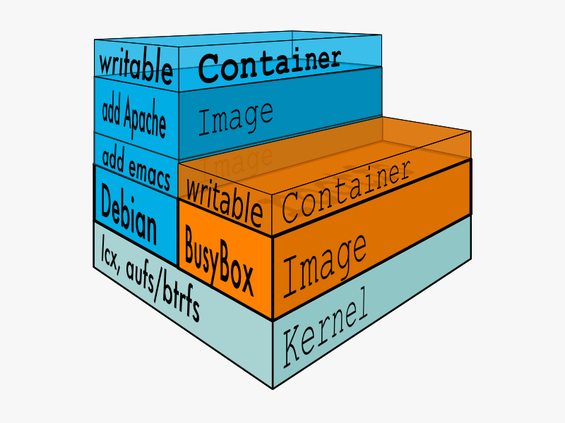
Images and layers
Notes:
docker images
(docker image ls)
Modify dockerfile
docker build -t abcam-zxtm:2.0 .
docker images
docker tag abcam-zxtm:1.0 abcam-zxtm:latest
docker images

Slide 15
Docker demo – .NET Core app
Notes:
Multi-stage dockerfile
Keep the size down
Create an image with only the necessary files

Slide 16
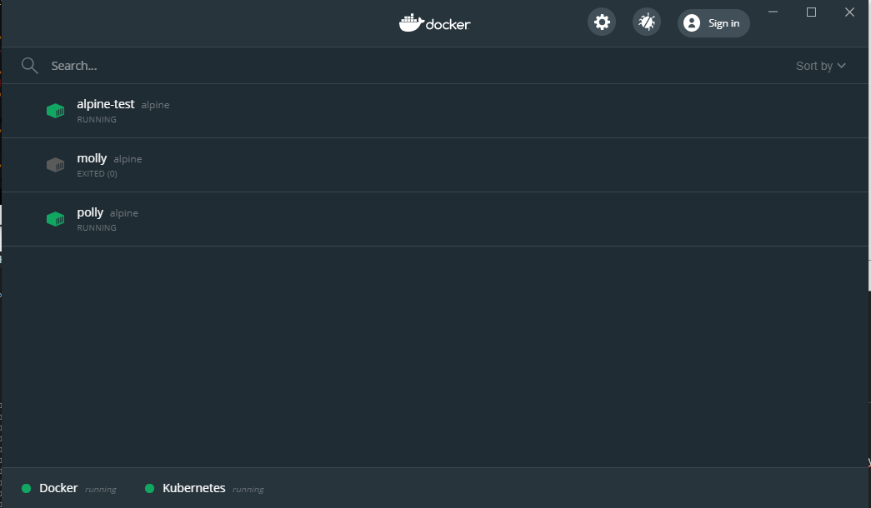
Docker demo – Docker Desktop

Slide 17
References
https://www.docker.com
https://www.docker.com/101-tutorial
https://training.play-with-docker.com
Notes:
Multi-stage dockerfile
Keep the size down
Create an image with only the necessary files

Slide 18
Docker demo – Extra networking
More about the default bridge network in Docker
Notes:
docker run -d -i -t --name pizza alpine ash
docker run -d -i -t --name pasta alpine ash
docker container ls
docker network inspect bridge
(show docker0 – not present in MacOS or Windows since it lives within the VM)
ifconfig
apk add iputil
traceroute www.google.com

